Slide 1
MWA ISS1003FP
Project Design Brief – Student
Name: Yeo En Ting
Register Number: 09
Class: S4-5

Slide 2
Content
Project Theme Selection
Describe your animation
Identify what is your project meant for?
E.g. Promotional animation, Simple game animation, Illustrative animation etc.
Identify your background Image
Identify your Character Images

Slide 3
Lead up to Project Theme Selection
Ask yourself | Pen down your thoughts
What is the theme of your Project? | Fast Food New Burger (Angus burger)
What is the purpose of your animation? | japanese girl saw the new burger, asked about the burger and order it.
What is the story that you want to tell? | japanese girl asking about the burger and odering it

Slide 4
Purpose of the Selection
Purpose ordering the new burger
Examples
To promote a sport event
To advertise a new gym
To promote a new product
To create a simple game

Slide 5
Describe your animation
Briefly describe how your animation will be like.
(1st scene) japanese girl walks in, saw and asked about the new angus burger.
(2nd scene) japanese girl ordering the burger.
(3nd scene) girl got the burger and walked out of the stall.
Example
A soccer player kicks a ball
The ball fly towards the goal post and become smaller
When the ball hits the goal post
The details of an upcoming match is displayed.
2 interactive buttons appears
1 button is for navigating to FAS website
1 button is for showing who is the player of the match

Slide 6
Identify the background image(s)
How will your background look like?
A background of a western restaurant
E.g.
Soccer Field

Slide 7
Identify your Character Image(s)
How many characters are there in your animation?
Angus burger
japanese girl
What are they doing in the animation?
the girl walk in the store and saw the new angus burger, and ordered the new angus burger.
Examples
One soccer player wearing blue Jersey with number 5.
He will be moving in from outside of the stage to kick the ball.

Slide 8

Attributing Images: E.g. 1
Authors | Title | Source (e.g. Websites) | Licence
Luidy | wood table | https://stock.adobe.com/search?filters%5Bcontent_type%3Aphoto%5D=1&filters%5Bcontent_type%3Aillustration%5D=1&filters%5Bcontent_type%3Azip_vector%5D=1&filters%5Bcontent_type%3Avideo%5D=1&filters%5Bcontent_type%3Atemplate%5D=1&filters%5Bcontent_type%3A3d%5D=1&filters%5Bcontent_type%3Aaudio%5D=0&filters%5Binclude_stock_enterprise%5D=0&filters%5Bis_editorial%5D=0&filters%5Bfree_collection%5D=0&filters%5Bcontent_type%3Aimage%5D=1&k=%22restaurant+background%22&order=relevance&safe_search=1&search_page=2&get_facets=0&search_type=pagination&asset_id=562177976 | Standard

Slide 9
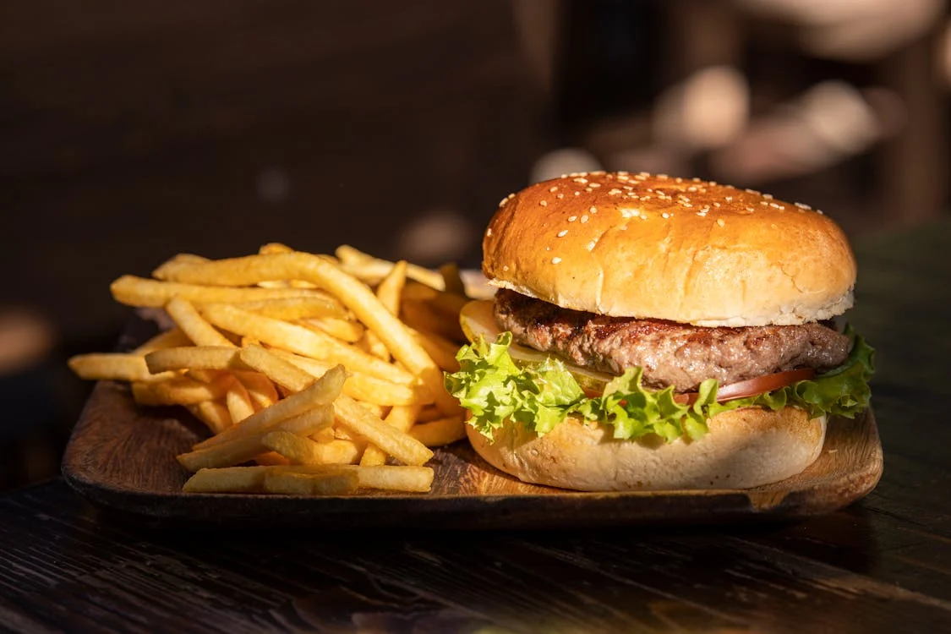
Attributing Images: E.g. 1
Authors | Title | Source (e.g. Websites) | Licence
Engin Akyurt | Plate of Fries and Angus Burger | https://www.pexels.com/photo/plate-of-fries-and-burger-3219483/ | Free

Slide 10
Project timeline
Period | Tasks | Status
Week 1 | Theme Selection
Week 2 | Source file is created and published in the required format
Week 3 | Media are used and integrated; also comply with copyright rules
Week 4 | Intro Animation is created based on project requirement
Week 5 | Intro Animation is created based on project requirement
Week 6 | Restart Button and 2 interaction buttons are created
Week 7 | Code is applied to user interaction component based on requirement – e.g. stop the animation; go to frame and play
Week 8 | Comments are written to explain the code
Week 9 | Test your animation on browser and refine your animation
Week 10 | What can be further improved?

Slide 11
Past Examples
https://sss.joycegsy.com/PeiEn/
https://sss.joycegsy.com/HongTing/
https://sss.joycegsy.com/Ezra/
https://sss.joycegsy.com/Aqmal/

